Slide 1

Revenue Optimization
for Bangkok Airbnb
By: Robert Susanto
Notes:
slidesppt.net

Slide 2
Agenda
01
03
02
04
Introduction
Exploratory Data Analysis
Strategic Business Plan
Data Preparation
Data Cleaning

Slide 3

01
Introduction
Notes:
slidesppt.net

Slide 4

About
This dashboard is built to help Airbnb hosts, property managers, and analysts make smarter decisions about listing strategies in Bangkok. It uses real-world Airbnb data to uncover insights on neighborhood performance all aimed at maximizing revenue and occupancy.

Slide 5


Problem
Many Bangkok Airbnb hosts struggle with uneven performance because they lack data on neighborhood demand, making it hard to decide where to launch or grow listings without a clear comparison framework.
Solution
Analyzing booking patterns helps reveal which areas perform better than others, and grouping neighborhoods together provides a clearer way to provide location-based revenue optimization.

Slide 6
Objectives
First
Identify high-performing neighborhoods
Analyze booking success rates to locate areas with strong rental demand.
Second
Group neighborhoods into tiers
Segment all districts into Tier Zones to simplify planning and maximize Return of Investment (ROI).
Third
Execute strategic expansion
Decide where to launch, expand, or exit based on neighborhood performance.
Notes:
slidesppt.net

Slide 7

02
Data Preparation
&
Cleaning
Notes:
slidesppt.net

Slide 8

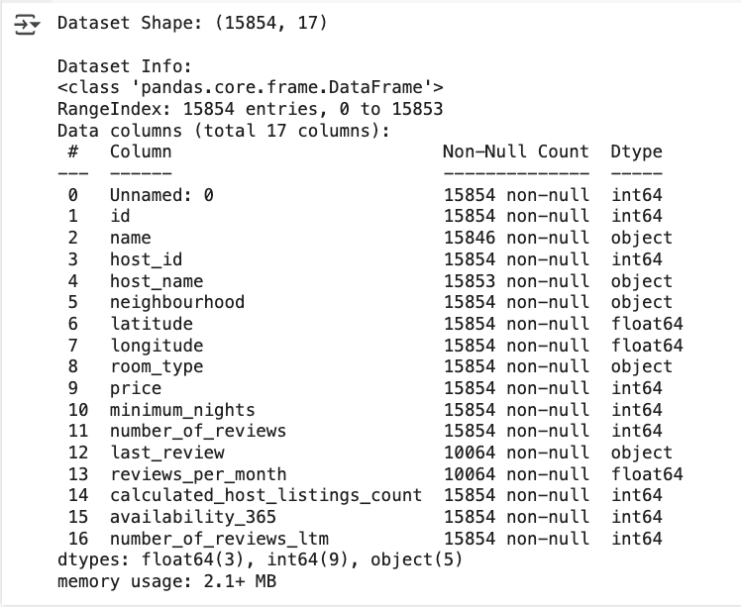
Data Preparation
The original dataset includes 15,854 Airbnb listings in Bangkok with 17 columns. It has a mix of numbers and text, making it easy to analyze and visualize using tools like Python and Looker.
Notes:
slidesppt.net

Slide 9
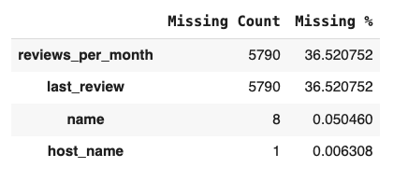
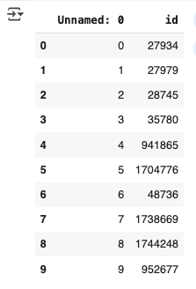
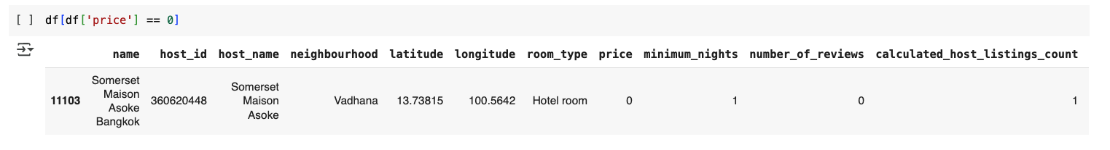
Data Cleaning
I dropped reviews_per_month and last_review columns because over 36% of their data was missing, making them unreliable for meaningful analysis.
For name and host_name, I retained these columns which had minimal missing values (<0.1%), and instead filled them with "Not Filled" to retain all listings and maintaining data integrity.
I dropped Unnamed: 0 because this is just an auto-generated index.
And dropped id because it is just an unique identifier.
I discovered a row that had a listing price == 0, so I dropped this listing.
Notes:
slidesppt.net

Slide 10
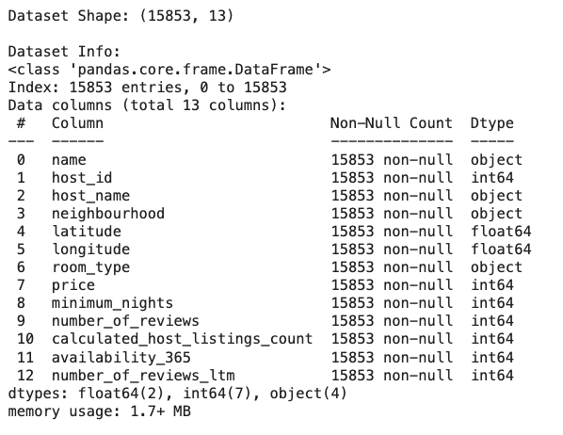
New Dataset
I removed 4 columns, reducing the dataset to 13 columns.
And I removed 1 row, which makes the total rows equal to 15,853 entries.
I will primarily be using the following columns:
neighborhood
long & lat
price
number of reviews
Notes:
slidesppt.net

Slide 11

03
Exploratory Data Analysis
Notes:
slidesppt.net

Slide 12
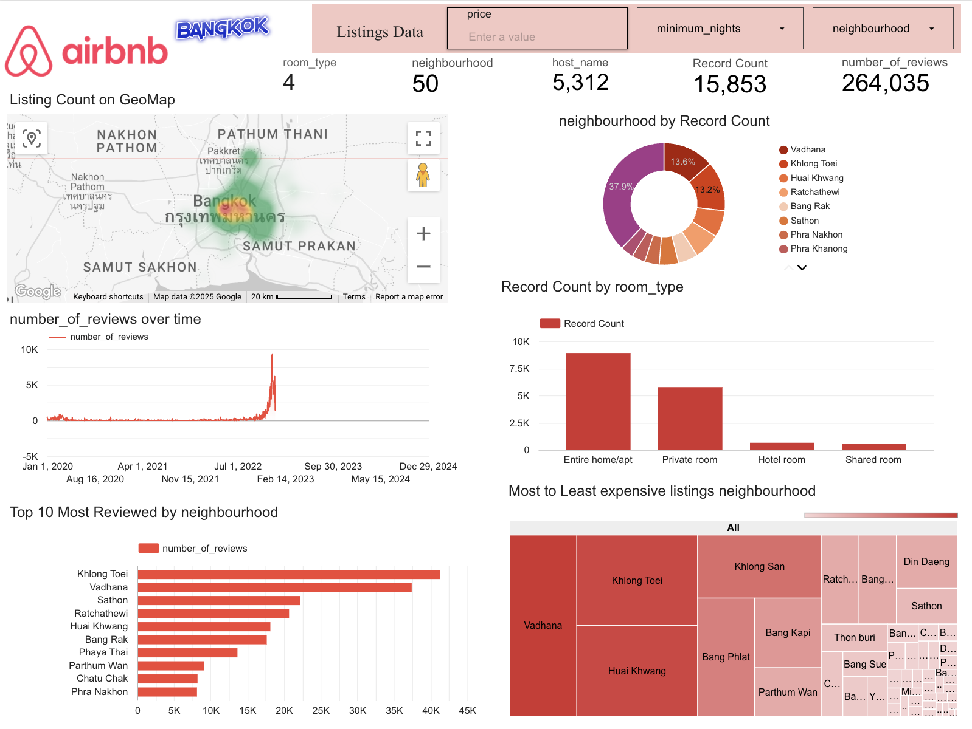
EDA: General Plotting
Key Findings:
Most listings in Bangkok are in central neighborhoods, showing these areas are the most popular with hosts and guests.
Reviews have gone up recently, meaning demand is strong again.
9 out of 10 most reviewed neighborhoods are in Central Bangkok via Geomap, which means that these locations consistently attract the highest bookings.
1
1
2
2
3
3
Notes:
slidesppt.net

Slide 13
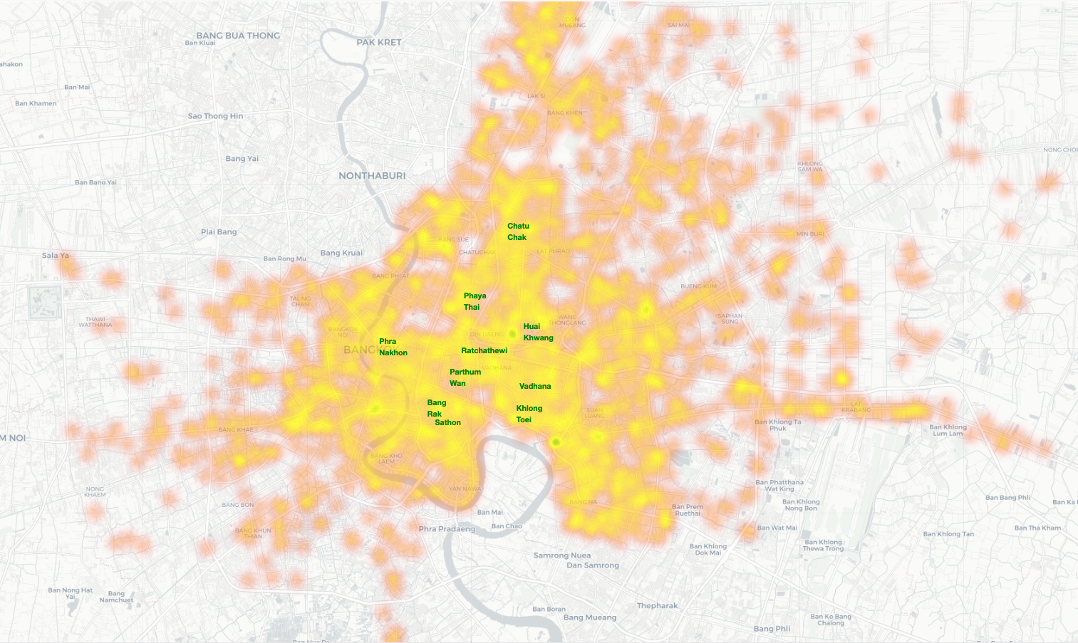
3
Via Geomap

Slide 14
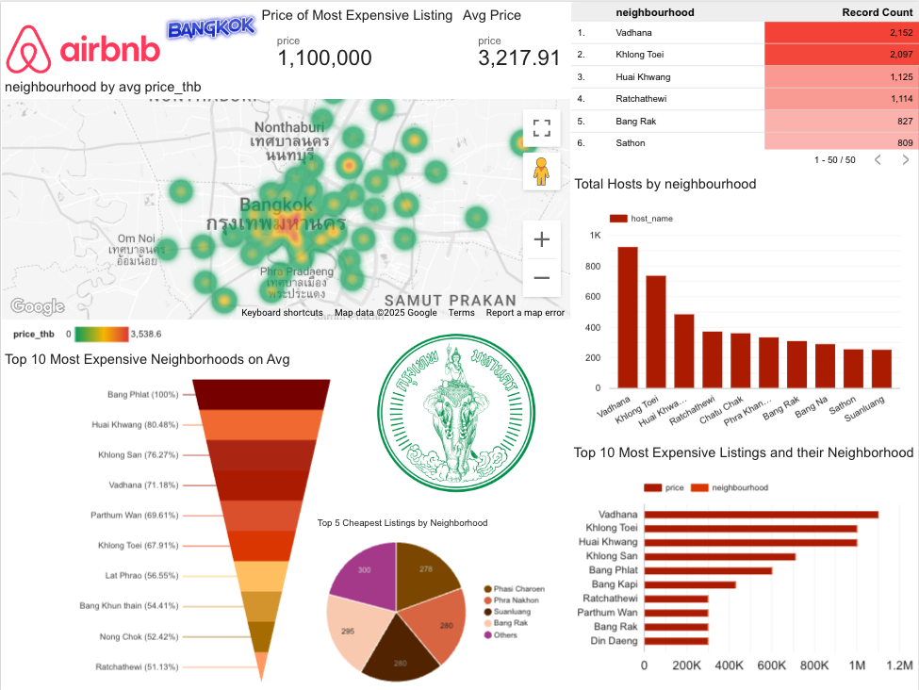
EDA: Neighborhood Analysis
Key Findings:
Most Airbnb Hosts primarily choose to have listings in Central or near-Central areas, where demands are higher than outer areas of Bangkok.
Average Listing prices are more expensive in these Central Neighborhoods, meaning I will use this data to optimize pricing strategies in these high-demand areas.
4
5
4
5
Notes:
slidesppt.net

Slide 15
How to effectively use Neighborhood Data in Revenue Optimization?
Notes:
slidesppt.net

Slide 16
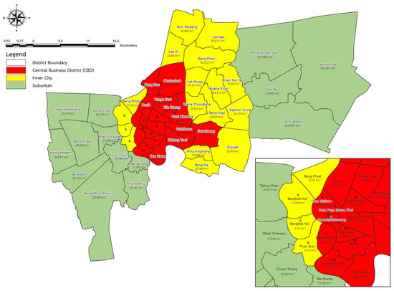
Introduction to Tier-Based
The following figure is a study conducted by Chulalongkorn University, which categorized districts based on infrastructure, land use, and activity levels to give the approach a strong academic foundation.
Tier 1 (CBD/Central): Densely built, commercial and financial hubs.
Tier 2 (Inner City/Mid): Mixed residential and commercial neighborhoods.
Tier 3 (Suburban/Outer): Outlying districts, mainly residential or agricultural.
Goal: Analyze Success rate of each Tier Zones.
Source: https://www.mdpi.com/2071-1050/15/19/14080

Slide 17
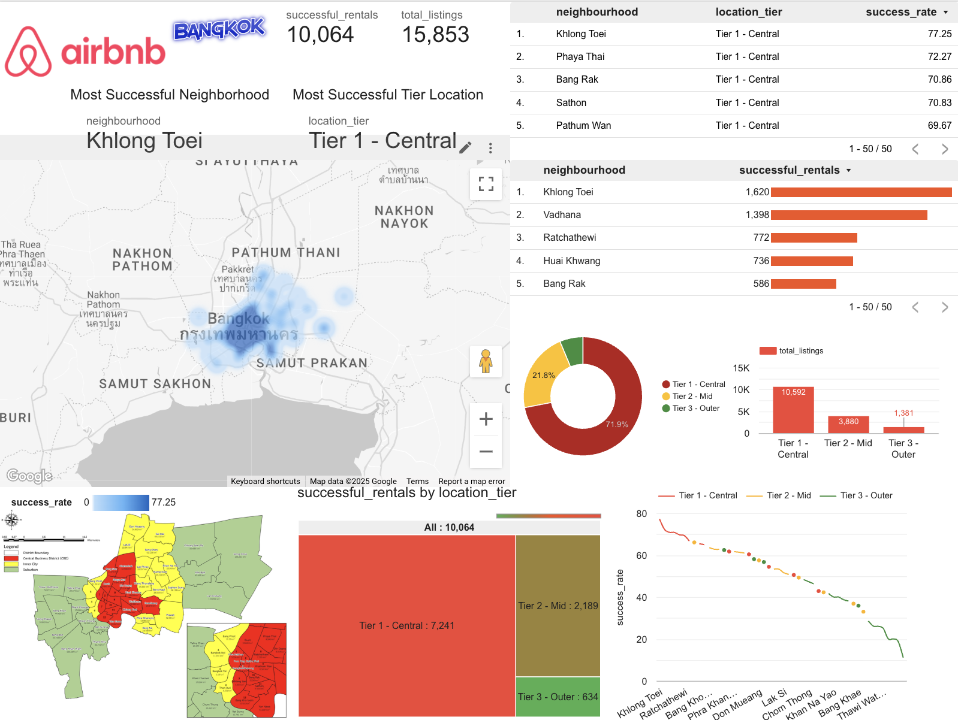
EDA: Tier System Analysis
Key Findings:
Performance of Each Tier via Total Successful Rental, where Tier 1 dominates with 71.9%.
Success Rate = Successfully Rented Listings / Total Listings, where the lower the Tier level, the lower the success rate will be.
Success Rate via Geomap, where the more outskirt the listing is from the CBD area, the lower the success rate will be.
6
8
7
6
8
7
Notes:
slidesppt.net

Slide 18
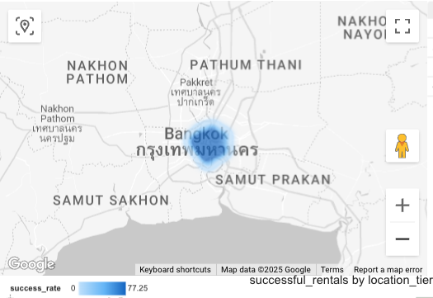
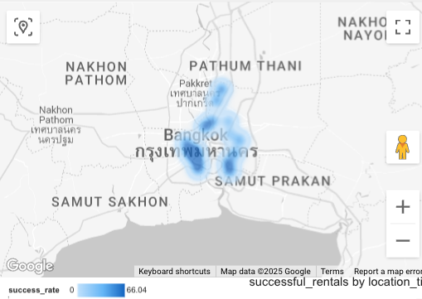
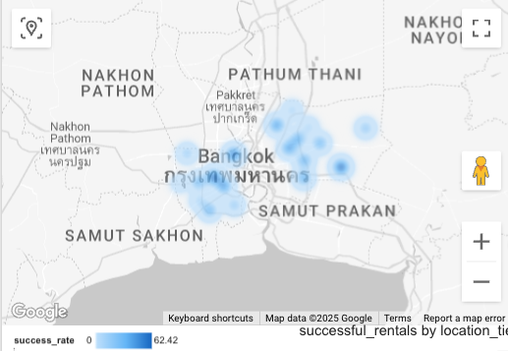
EDA: Tier-System Results
Tier 1
Tier 2
Tier 3
Success Rate
2,189/3,880
56.48%
Success Rate
634/1,381
45.91%
Success Rate
7,241/10,592
68.36%

Slide 19

04
Strategic Business Plan
Notes:
slidesppt.net

Slide 20
Tier 1 Listings
Tier 2 Listings
Tier 3 Listings
01
02
03
Strategy:
Maintenance
Dynamic Pricing
Description:
Maintain quality of performance while steadily increasing the price (start with 10% increase) in proportion to the demand.
Example:
Holiday Periods
Summary Action:
Tuning
Strategy:
Experiment
Refine Advertisement
Increase Amenities
Description:
Test different pricing, include excellent photos of the listing and inputting keywords such as “near MRT and shopping malls.” Improving in-room amenities.
Summary Action:
Scaling
Strategy:
Downscale
Critical Review Required
Exit Strategy Consideration
Description:
Reassess underperforming listings and consider withdrawing or repurposing units if improvements don’t yield results.
Summary Action:
Revamping
BUSINESS PLAN

Slide 21
Who will benefit from this research analysis?
Notes:
slidesppt.net

Slide 22

Persona
Alex Smith – The Strategic Airbnb Host
About Alex:
Full-time Airbnb host managing 5+ listings across Bangkok.
Actively looking to expand into new districts but skeptical about the return of investment.
Pain Points:
“Some units sit empty while others are always booked.”
“I’m guessing on pricing without understanding local demand.”
Goals & Needs
Prioritize profitable expansions by investing in higher performing zones.
Avoid revenue loss from lower performing areas.
How the Tier System Helps Alex
Removes guesswork in neighborhood selection.
Focuses attention on high-potential zones and help make smarter resource allocation for scaling operations.

Slide 23
Conclusion
Neighborhood Classifications
based on performance allows hosts to tailor pricing, marketing, expansion strategies to the specific demands of each area.
Strategic Location
such as near MRT stations, shopping centers, or touristy spots that mostly can be found in Central areas tend to increase guest appeal.
Data is Key
as it help hosts in deciding where to allocate their resources.

Slide 24

Thank you!
Template: slidesppt.net
Notes:
slidesppt.net

